Slide 1
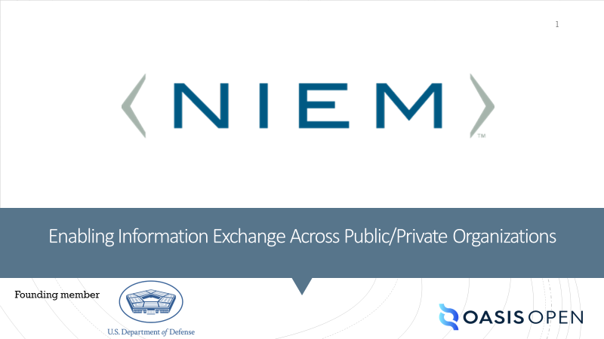

Slide 2
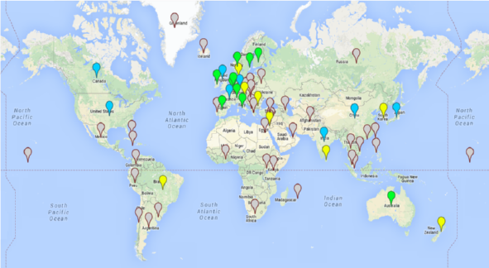
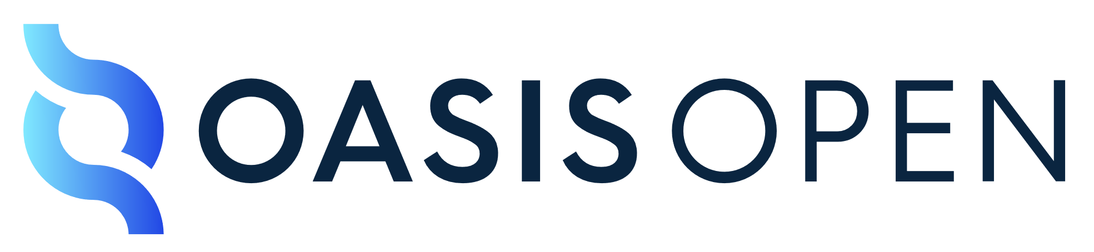
6
CONTINENTS
2000+
PARTICIPANTS
70+
COMMUNITIES
Nonprofit, 501(c)(6) organization hosting open standards and open-source projects
Built on principles of open process, inclusive participation, and innovation
Members set the technical goals & run their projects
Maintain accreditation and liaison relationships with multiple global and regional formal bodies: ISO, ITU, IEC (JTC 1), ANSI
150+
STANDARDS
Notes:
OASIS is a nonprofit, international, member-driven organization founded in 1993. We provide support for open standards and open source development.
We’re the home of a lot of standards that you’re probably familiar with—SAML, OpenDocument Format, XACML, MQTT, the Common Alerting Protocol We have a broad scope of work, cybersecurity, blockchain, privacy, sharing economy, cryptography, cloud computing, augmented reality, emergency management, legal.
We understand how transparent, fair community development gets done. Partners and competitors come to OASIS as a safe haven where they can produce solutions to common problems. We know how to support them and guide them to success.
We try to be as flexible as possible in serving the varying needs of different communities. Groups at OASIS work autonomously, setting their own goals, making their own decisions… under principles of openness, transparency, inclusivity…those are things we stand firm on.
Our process is recognized by the de jure bodies our work often goes on to be published by ISO, IEC, and ITU.

Slide 3

Global, nonprofit consortium for advancing open standards and open-source projects
Promotes interoperability, innovation, and freedom of choice
Broad agenda: cybersecurity, emergency, legal, digital trade , IoT, AI, cloud computing, blockchain…
Member of European Multi-Stakeholder Platform on ICT Standardization→ EU allows OASIS specs to be referenced in public procurement.
De jure relationships that offer path for ratification by ISO, IEC (JTC 1), and ITU
Home of Baseline, UBL, ebXML, BDXR (PEPPOL messaging), SAML, OpenDocument, STIX, TAXII, KMIP, PKCS 11, OpenC2, CAP, TOSCA, OData, MQTT, AMQP, Dita…
Notes:
Many of you are familiar with OASIS but some are not. OASIS is a nonprofit, international, member-driven organization founded in 1993.
We’re the home of a lot of standards that you’re probably familiar with … you probably come into contact with at least one OASIS standard every day…
Whenever you open a document, you're using OpenDocument Format, whenever you sign on to a website, you're probably using SAML, if you unlock your car using your phone, you're using MQTT. In fact, we have already collaborated with NIEM for the development of the Amber alert, which uses the OASIS common alerting protocol in action.
Many OASIS Standards have gone on to be published by ISO, IEC, ITU, and UN/CEFACT. That’s an avenue that’s certainly open to NIEM.

Slide 4
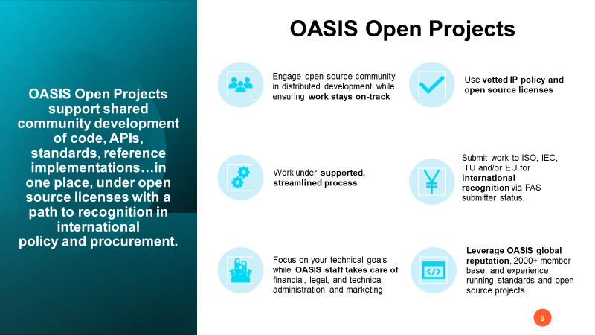

Slide 5

What core services does OASIS provide?
Legal entity, management of trademarks and copyrights
Contributor License Agreement administration
Collaboration tool set: GitHub org, mailing group, calendar, roster, ballot, asynchronous chat, video meetings…
OASIS Standards process submission management
Submission of approved deliverables to ISO, IEC, ITU via OASIS liaison
Community management support
Assistance in writing charter, Code of Conduct, other policies
Governance administration and support
Support for project assets such as website design, hosting, site maintenance, collateral and logo design
Press, promotion & outreach to attract developers and sponsors
Meeting planning and coordination
Free public access to deliverables in perpetuity
Notes:
… the main reason to sponsor NIEM OASIS and NIEM is because you want this project to succeed, because you realize the success of NIEM will have a positive, direct impact on your company.
Anyone can participate technically in NIEM with no fees—and we value those contributions very much—but that means the only way to provide the core services the project needs is through corporate sponsorship. Your support makes it possible for OASIS to provide—the licensing and trademark management, the standards submission option, the collaboration tool package, the community management, the governance support that ensures fairness and openness, the hallmarks for acceptance by de jure bodies and in government procurement, the marketing and outreach activities…these core services are only possible with Sponsor support.

Slide 6
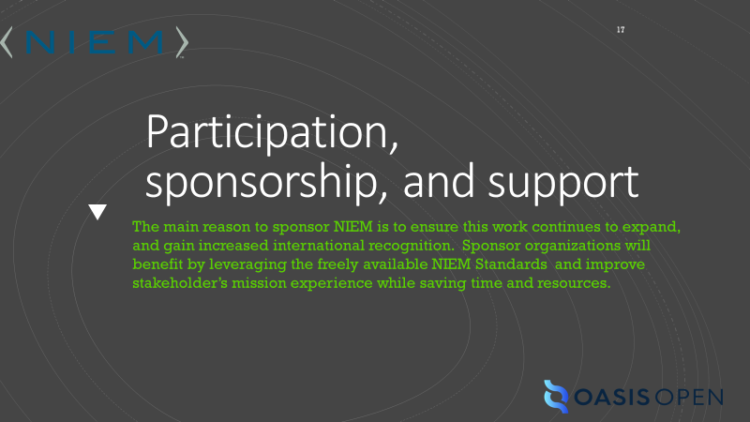

Slide 7
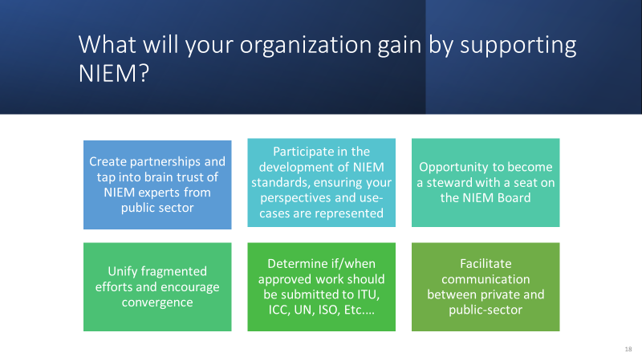

Slide 8
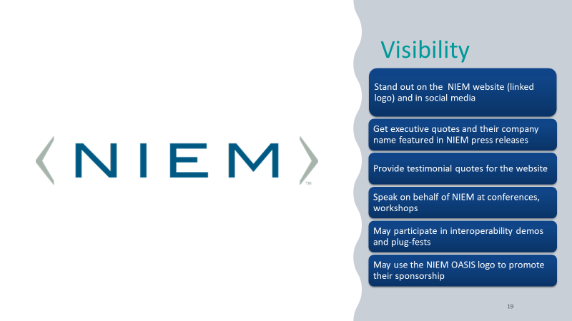

Slide 9
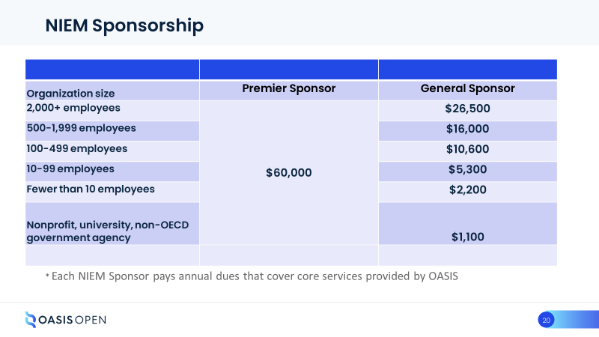

Slide 10
